Slide 1
Early Detect Problematic File Groups During Software Evolution
Di Cui¹, Ting Liu¹, Yuanfang Cai², Qinghua Zheng¹,
Wuxia Jin¹, Qiong Feng², Yu Qu¹
¹Department of Computer Science, Xi’an Jiaotong University
²Department of Computer Science, Drexel University
11/22/2018
Notes:
Hello everyone, my name is di cui. I am so glad to here to present my work. Early detect problematic file group during software evolution.

Slide 2
Content
1、Introduction
2、Case Study
3、Methodology
4、Experiment
5、Conclusion
6、Question

Slide 3
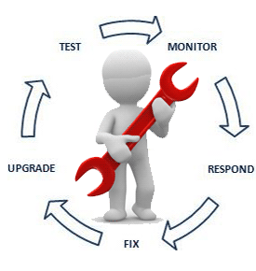




Software Quality and Structure
As software evolves, an increasing amount of maintenance efforts were spent on software quality assurance.
The rapid growth of complex software structure poses great challenge to maintenance activities.
Easier
Software Maintenance
Software Structure
Technical Debt
Notes:
As we all know, as software evolves, an increasing amount of maintenance efforts were spent on software quality assurance.
According to the statistic data, the cost on software maintenance domiate over 80% of all the cost.
An signifcant factor is evolution of software strucutre. The complex structure poses great challenge to our maintenace effort, our software are more likey to accumulate techincal debt

Slide 4
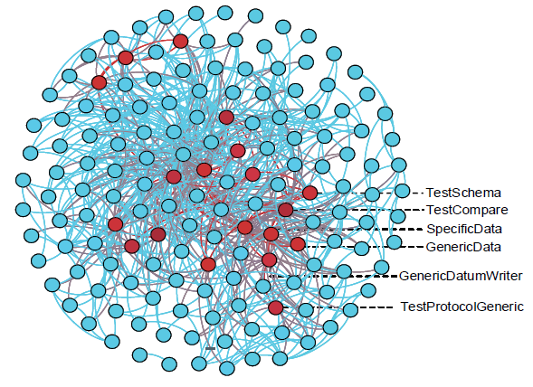
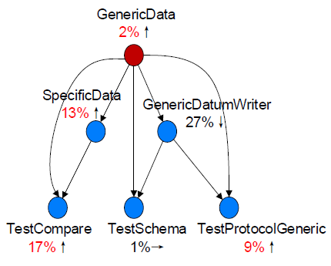
Problematic File Group
For a software system, there always exist several file groups frequently incurring bugs and changes, referred to Problematic file group (PFG).
Two symptoms:
Structural-connected [1]
Accumulating maintenance cost during software evolution
Take a PFG in AVRO as a example:
This PFG contains:
6 files
8 relations
Pyramid structure
Unstable Interface
[1] Structural relation includes inheritance, implementation, method call, field access, type reference and instance creation

Slide 5
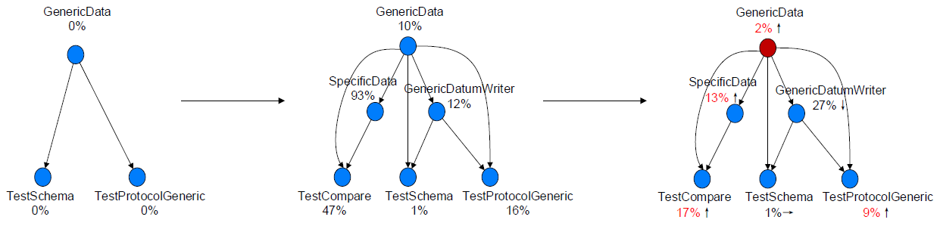
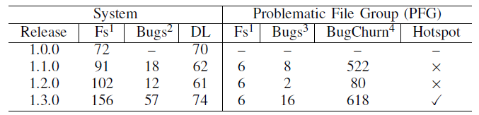
The Evolution of Problematic File Group
We traced the revision history of this PFG:
X% represents the bug ranking
Avro 1.0.0
Avro 1.1.0
Avro 1.3.0
The Maintenance cost on this PFG
File in system/PFG
Bugs in system
Bugs involved at least one file in PFG
LOC spent on PFG
first introduced in 1.1.0 during a architectural change (AVRO-110)
spent nearly 700 lines of code related to 18 bugs
If this PFG can be detected earlier and fixed in time, it is possible to avoid the increasing maintenance cost.

Slide 6
Content
1、Introduction
2、Case Study
3、Methodology
4、Experiment
5、Conclusion
6、Question

Slide 7
State-of-the-art Relevant Techniques
State-of-the-art techniques to diagnose PFG:
The Maintenance cost on this PFG
File in system/PFG
Bugs in system
Bugs involved at least one file in PFG
LOC spent on PFG
Metric-based approach, such as DL:
Monitor software structure health in time
Cannot locate the PFG directly
History-based approach, such as hotspot:
Identify suspect file groups using adequate revision history
Cannot detect the PFG as soon as it was introduced
We need an approach to early detect PFG during software evolution.

Slide 8
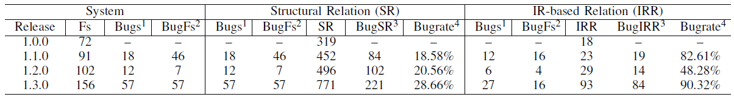
Software Relation Analysis
Software Relation may be involved in PFG:
Structural Relation: contain inheritance, implementation, method call, field access, type reference, and instance creation
IR-based Relation: measure the textual similarity between source code lexicons, including class name, method name, variable name and comment
Structural Relation vs IR-based Relation
The number of bugs in system and the number of bugs involved at least one file in SRs/IRRs
The number of bug-prone files in system, SRs or IRRs
The number of SRs/IRRs in which both of involved files are bug-prone
The rate of BugSRs/BugIRRs in all SRs/IRRs
We discovered that bug-prone files are likely to be information-retrieval related (involved in IR-based relation).

Slide 9
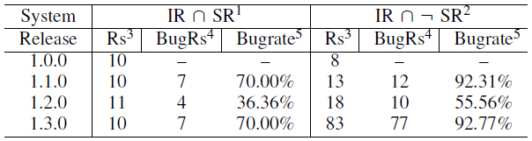
Software Relation Analysis
The interaction of IR-based relation and Structural Relation:
The intersection of IRRs and SRs
The difference of IRRs and SRs
The number of software relations
The number of buggy Rs/BugIRRs
The rate of BugRs in all Rs
We discovered that:
The combination of structural relation and IR-based relation capture newly introduced bug-prone files
A typical pattern, the difference of IRRs and IRs, to hint PFG. This is also a violation of information hiding principle [1]
We employ this pattern, referred to SFP (suspect file pair), to assist us detect PFG at early stage !
[1] Parnas D L . On the criteria to be used in decomposing systems into modules[J]. Comm Acm, 1972, 15(3):1-50.

Slide 10
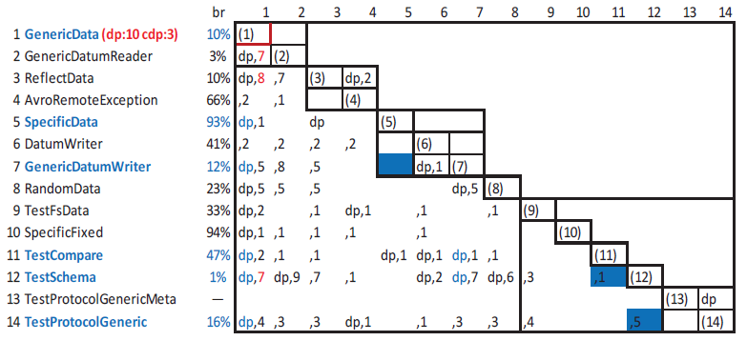
Representing PFG using DSM
We employ design structure matrix to analyze PFG:
Module
layer
Relation
DSM is a square matrix, where the rows and columns are labeled with the same set of source files in the same order.
Layers and modules.
Multiple Relations. For example, Cell(2,1) is marked with “dp,7”:
“dp” means GenericDatumReader structurally depend on GenericData
“,7” means GenericDatumReader and GenericData change together with 7 times.

Slide 11
Relation Analysis in PFG
We analyze the structural relation and semantic relation in this PFG:
Three major steps to discover PFG:
Locating Suspect File Pair (SFP): (5,7), (11,12), (12,14)
Searching Suspect File Unit (SFU): (1:5,7), (7:11,12), (1:12,14)
Merging Suspect File Group (SFG): (1: 5,7,11,12,14)
We detect PFG by locating SFP, searching SFU and merging SFG.

Slide 12
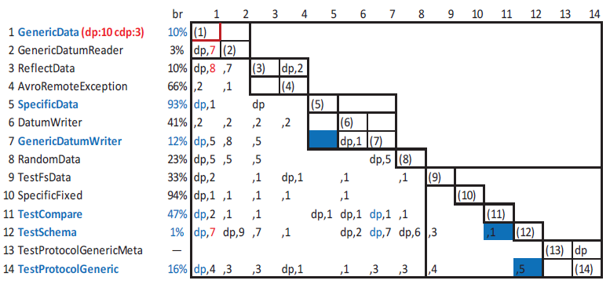
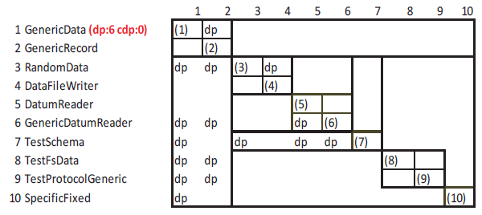
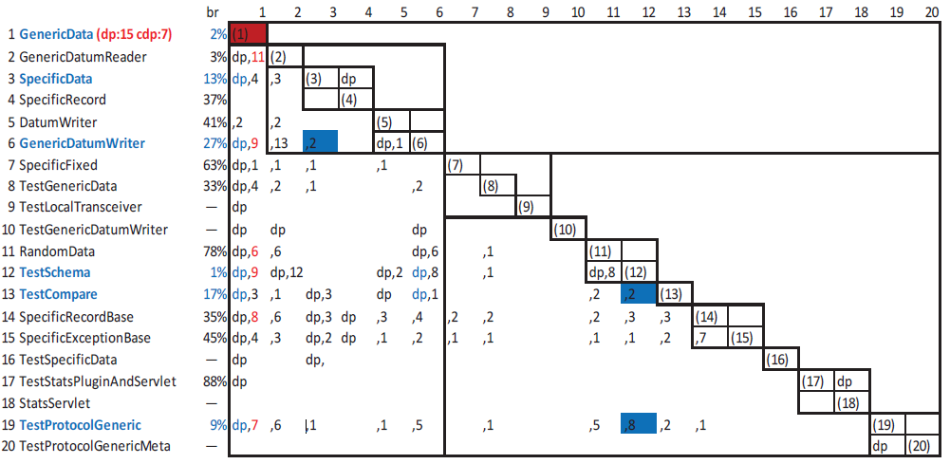
A Comparison of Detecting PFG
Avro 1.0.0 DL=70% Hotspot=FALSE Our=FALSE
Avro 1.1.0 DL=62% Hotspot=FALSE Our=TRUE
Avro 1.1.0 DL=62% Hotspot=TRUE Our=TRUE
Our method can detect PFG accurately at early stage!

Slide 13
Content
1、Introduction
2、Case Study
3、Methodology
4、Experiment
5、Conclusion
6、Question

Slide 14
Methodology
Four steps to detect PFG:
Extracting structural relations and IR-based relations: we crawl structural relation using Understand and IR-based relations using lexicon parser.
Collecting Suspect File Pairs (SFP): SFP is a pair file captured by IR-relation but not structurally connected.
Generating Suspect File Units (SFU): SFU is a triple including SFP and their nearest common ancestor.
Constructing Suspect File Groups (SFG): SFG is obtained by recursively merging SFU.
Finally, our method can detect several suspect file groups (SFG) to predict PFG accurately at early stage!

Slide 15
Content
1、Introduction
2、Case Study
3、Methodology
4、Experiment
5、Conclusion
6、Question

Slide 16
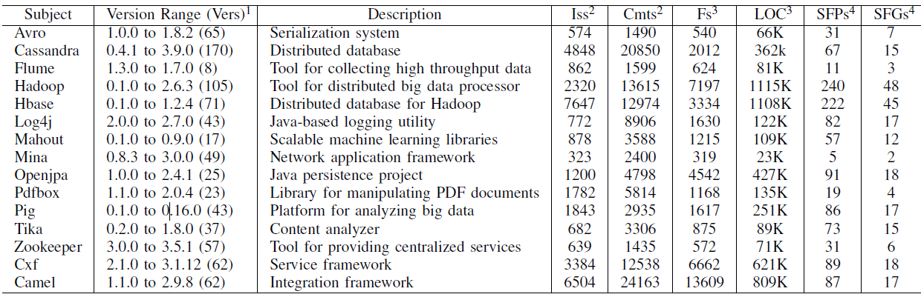
Selecting Subject
We investigated 838 versions of 15 Apache open projects including 33353 bug reports and 86690 revision commits to evaluate our approach
We crawled bug reports using issue tracking system (JIRA) and revision history using version control system (GIT)

Slide 17
Research Question
In this section, we design four research questions to evaluate the effectiveness of our approach:
RQ1: Whether the files identified in SFGs will change together with each other?
RQ2: Whether the files identified in SFGs will incur high maintenance costs in the subsequent versions?
RQ3: What is the accuracy of SFGs?
RQ4: How early can our approach discover PFG?

Slide 18
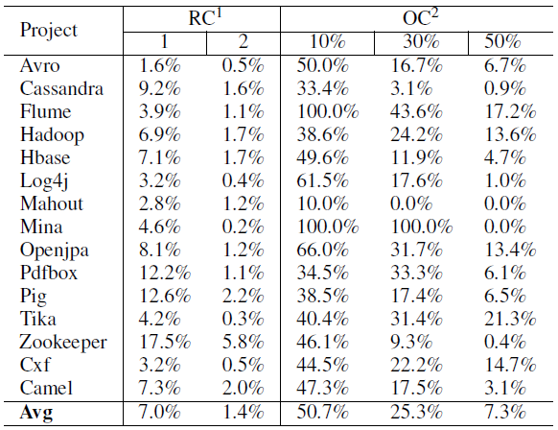
RQ1: The co-change of SFG
We use two metrics to measure the co-change of SFG
RC: measures the number of related commits in which a SFG are involved
OC: measures the distribution of the overlapping of involved files in SFG in co-change commits
We found that :
SFG participates in a significant amount of revision commits (8%)
The co-change commits in SFG are only 1.4%
For the co-change commit, 50% of them are involving less than 10% of files in SFG
SFG may participate in a large amount of commits but they do not frequently and completely change together

Slide 19
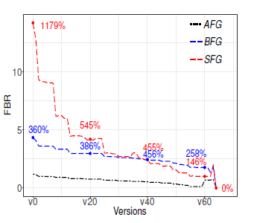
RQ2: The Maintenance cost of SFG
We use two metrics: FBR and FCR to measure the impact of SFGs on software maintenance:
FBR/FCR: calculate the average bug/change frequency of each file involved in SFG from version vi to vn.
Three strategies [1].
The green marked points represents the average frequencies in bugs for the files in SFG from v0 to v64.
The black marked number represents the rate of SFG compared with AFG.
[1] AFG represents all the files. BFG represents all the bug-prone files. SFG represents our detected files.

Slide 20
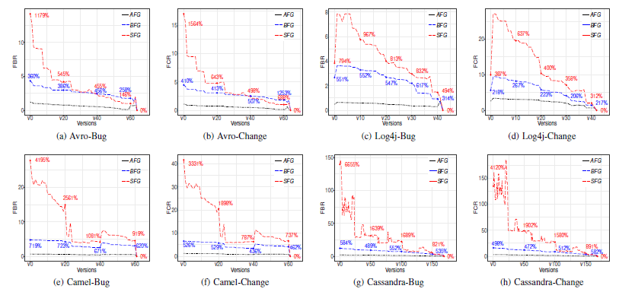
RQ2: The Maintenance cost of SFG
We measure the FBR and FCR of these projects and found that:
Compared with AFG, SFG presents enough high bug rate
Compared with BFG, SFG concentrate on the most bug-prone file group

Slide 21
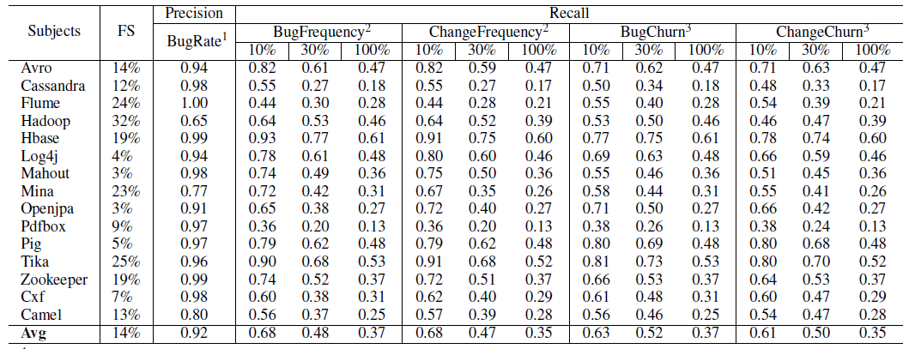
RQ3: The accuracy of SFG
We evaluate the precision and recall of SFG from four perspectives:
The identified files in SFG is limited (3%-32% of all the files)
The bug rate is up to 92%
SFG participate in a significant percentage (61%-68%) of the top 10% bug-prone and change-prone files

Slide 22
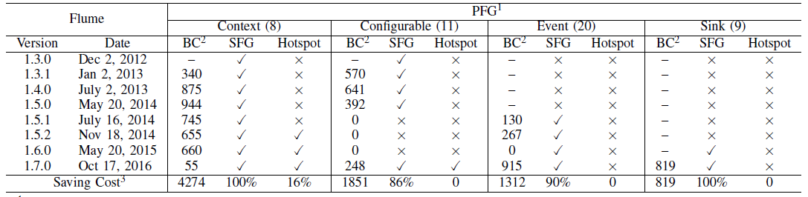
RQ4: The timeliness of SFG
We make a comparison of our approach and hotspot in Flume of 8 versions and discovered:
Our method can detect PFG as soon as they were firstly introduced
Our method would help developer save large number of lines of code (1000+) to fix bugs by early detecting PFG.
Our method can also detect PFGs missed by Hotspot.

Slide 23
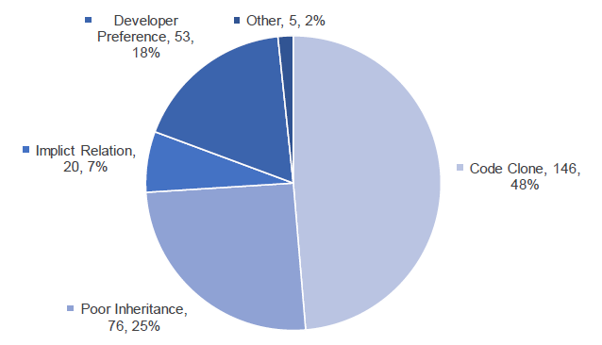
Discussion
Our approach is based on SFP. We sample 300 file pair and summarize four reason for SFP:
Code Clone: (146, 48%)
Poor Inheritance: (76, 25%)
Implicit Relation: (20, 7%)
Developer Preference: (53, 18%)
Other: (5, 2%)
The code clone is the most common reason (48%)
The implicit relation is merely 6.7%
98.3% of the samples can be summarized these 4 reasons

Slide 24
Content
1、Introduction
2、Case Study
3、Methodology
4、Experiment
5、Conclusion
6、Question

Slide 25
Conclusion
In this section, we designed an approach to early detect problematic file groups (PFG). We evaluated our method on 838 version of 15 projects. The experiment showed that:
The identified groups only use 14% of all the files
Almost 70% of the top 10% bug-prone files are covered by the identified groups
The precision of identified groups is as high as 92%
The identified file groups will incur 957% bugs and 1050% changes in future versions than average

Slide 26
Content
1、Introduction
2、Case Study
3、Methodology
4、Experiment
5、Conclusion
6、Question

Slide 27
Reviewer’s Question
In this section, we answer three questions proposed by reviewers:
Q1: It is not clear why we need to detect problematic file group?
A: We added the definition of PFG and detailed analysis in running example to illustrate our motivation. The problem file group is considered as a form of technical debt, which will keep consuming maintenance costs.
Q2: The evaluation does not measure whether these file groups change
A: We additionally add a research question to measure the co-change of SFG and find that the SFG are frequently changed but not co-change together.
Q3: The measurement used in RQ1 seems to be flawed?
A: We redefine the measurement used in RQ1 and provide three strategies to proof the validity of our approach.

Slide 28
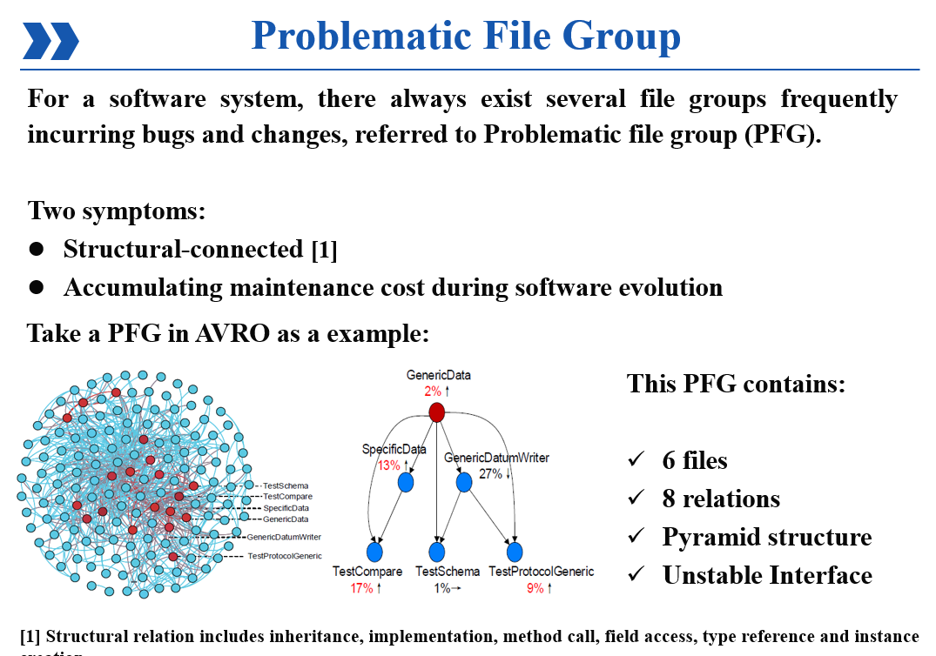
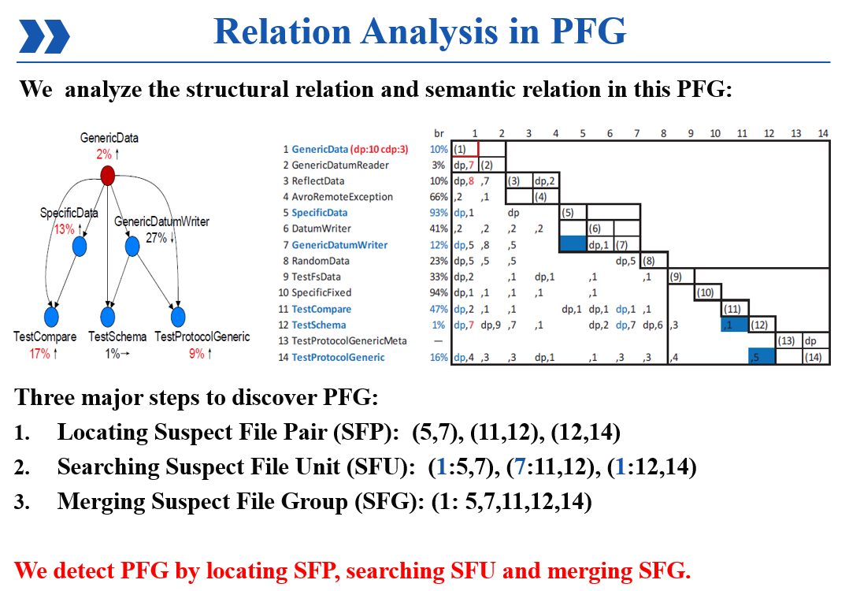
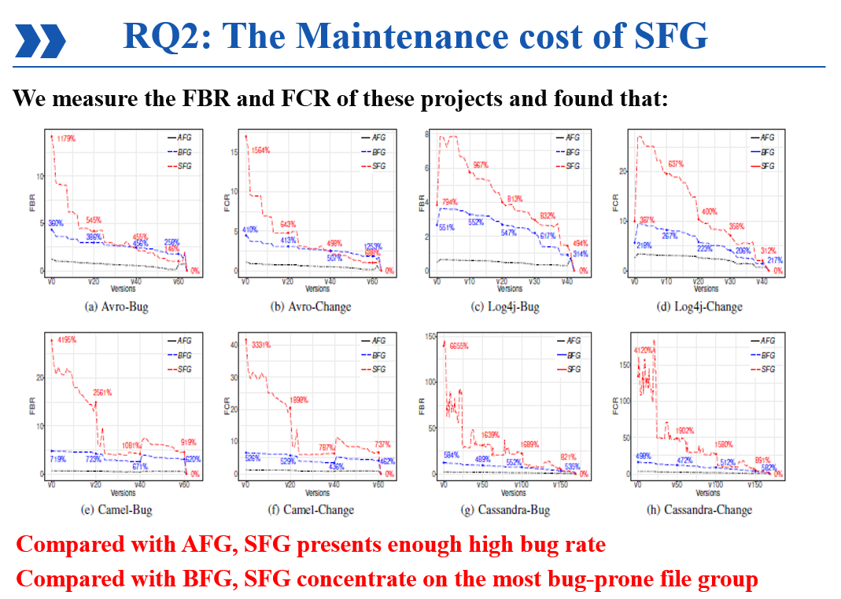
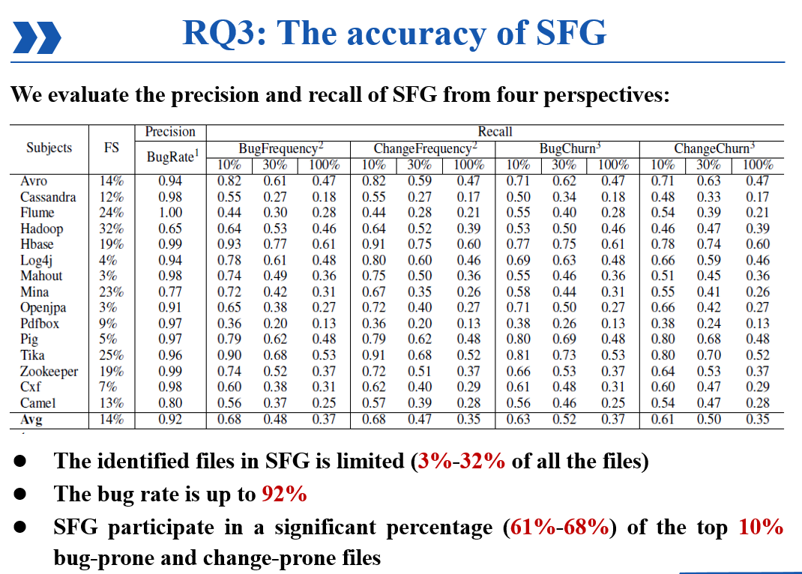
Thanks
Thanks！Q&A

